Slide 1
Trading Platform using Hyperledger Fabric
Presented by (Team-6) : Vamshi Krishna Shanagonda
Sai Jeevan Teegala
Akhila Katukuri

Slide 2
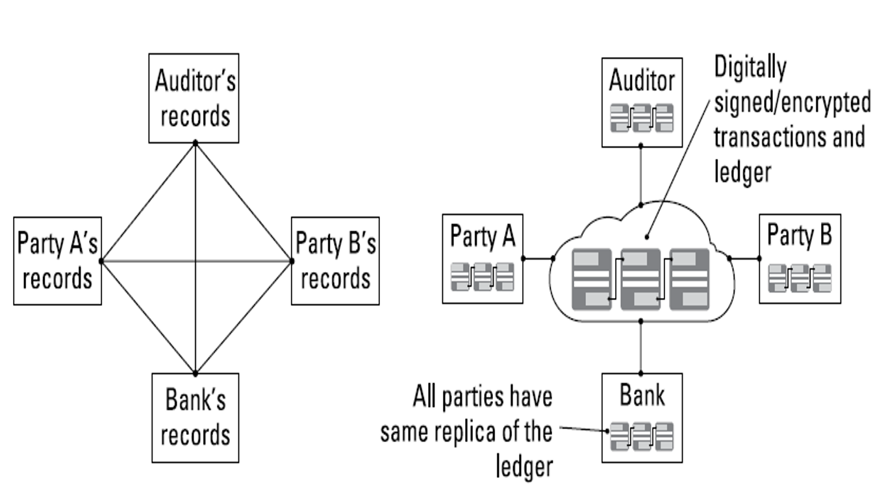
Maintenance of Ledgers:
The shortcomings of current transaction systems

Slide 3
What is Blockchain Technology
Blockchain is a system of recording information in a way that makes it difficult or impossible to change, hack, or cheat the system.
Blockchain is a distributed ledger technology (DLT) that allows data to be stored globally on thousands of servers – while letting anyone on the network see everyone else's entries in near real-time.
A blockchain is a digital record of transactions. The name comes from its structure, in which individual records, called blocks, are linked together in single list, called a chain. Blockchains are used for recording transactions made with cryptocurrencies, such as Bitcoin, and have many other applications.

Slide 4
Applications of Blockchain
The first major blockchain innovation was bitcoin, a digital currency experiment.
The second innovation was called blockchain, which was essentially the realization that the underlying technology that operated bitcoin could be separated from the currency and used for all kinds of other interorganizational cooperation.
Advantages
Fast
International
Easy accounting
Weighs nothing
Cheap

Slide 5
Blockchain Structure

Slide 6
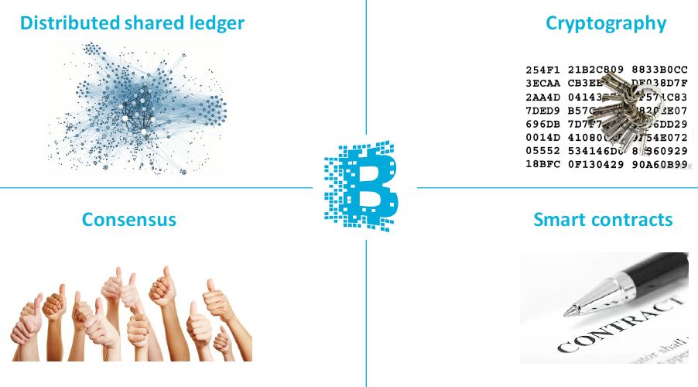
4 Key Concepts of Blockchain

Slide 7



Blockchain Architecture
Revolutionary Technology
TCP/IP, HTTP, Cloud Computation, Big Data, IoT, FinTech…
Blockchain versions:
Blockchain 1.0
Bitcoin
Programmable Money
Blockchain 2.0
Ethereum
Smart Contract
Blockchain 3.0…
Non-Financial Uses
It is also used in many other applications.

Slide 8
Blockchain vs. Current Banking System
Decentralized System
The Blockchain system follows a decentralized approach when compared to banks and financial organizations which are controlled and governed by Central or Federal Authorities.
Here, everyone who is involved with the system holds some power.
Public Ledgers
The ledger which holds the details of all transactions which happen on the Blockchain, is open and completely accessible to everyone who is associated with the system.
Even though the complete ledger is publicly accessible, the details of the people involved in the transactions remains completely anonymous.
Verification of Every Individual Transaction
Every single transaction is verified by cross-checking the ledger and the validation signal of the transaction is sent after a few minutes.
Through the usage of several complex encryption and hashing algorithm, the issue of double spending is eliminated.
Low or No Transaction Fees
These transaction fees are however relatively quite less when compared to the fees implied by banks and other financial organizations.
If a transaction needs to be completed on priority then an additional transaction fees can be added by the user so as to have the transaction verified on priority.

Slide 9
The key business benefits:
Time efficient
Cost efficient
Tighter security
Enhanced privacy
Improved auditability
Increased operational efficiency

Slide 10
Building trust with blockchain
Distributed and sustainable
Secure, private, and indelible
Transparent and auditable
Consensus-based and transactional
Orchestrated and flexible

Slide 11
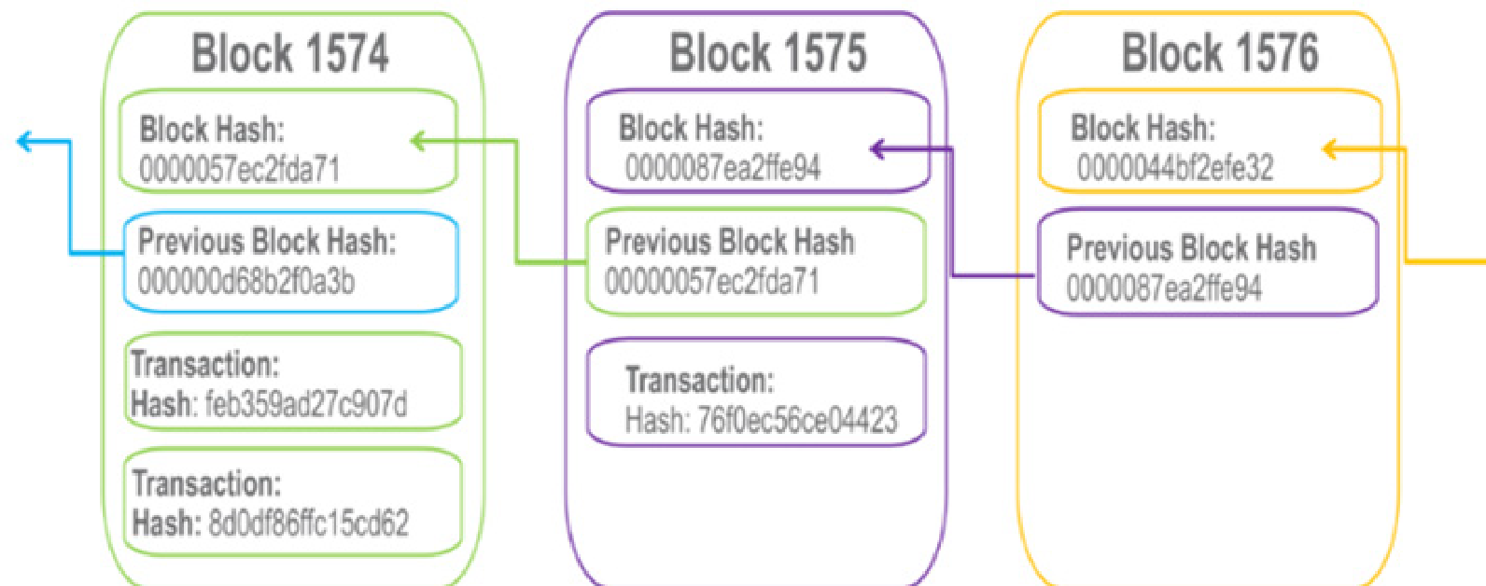
Why It’s Called “Blockchain”

Slide 12
Different Players in Implementation
Blockchain user
Regulator
Blockchain developer
Blockchain network operator
Traditional processing platforms
Traditional data sources
Certificate authority

Slide 13
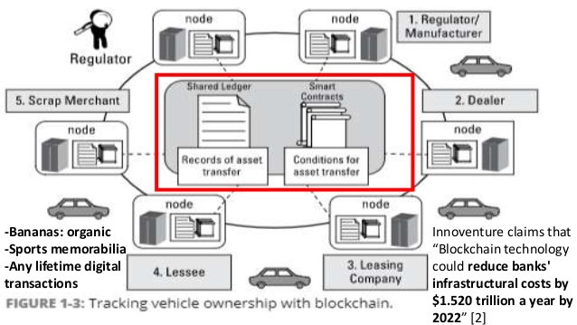
BlockChain use-case (dubai)

Slide 14
HyperLedger Introduction

Slide 15
Hyperledger Fabric
The Linux Foundation founded Hyperledger in 2015
Hyperledger Fabric is a platform for distributed ledger solutions in industrial level.
A modular architecture - Delivers high degrees of confidentiality, resiliency, flexibility and scalability.
It is designed to support pluggable implementations of different components, and accommodate the complexity and intricacies that exist across the economic ecosystem.
Breaks from some other blockchain systems is that it is private and permissioned

Slide 16
Hyperledger Fabric - Cont.
Like other blockchain technologies, it has a ledger, uses smart contracts, and is a system by which participants manage their transactions.
Ledger data can be stored in multiple formats, consensus mechanisms can be switched in and out.
Offers the ability to create channels, allowing a group of participants to create a separate ledger of transactions.
Hyperledger is based on blockchain but its not a cryptocurrency.
Hyperledger in general do not enforce any requirements about the hardware, network infrastructures, additional software around it, security models etc.
Operational power: 0.5 million operations per minute where as other blockchain does only 1000.

Slide 17
Advantages of Hyperledger Fabric
Permissioned membership
Performance, scalability, and levels of trust
Data on a need-to-know basis
Rich queries over an immutable distributed ledger
Modular architecture supporting plug-in components
Protection of digital keys and sensitive data

Slide 18
Hyperledger Components
Fabric CA:
Fabric CA stands for Certificate Authority (CA) for Hyperledger Fabric.It provides features such as: registration of identities into the user registry, issuance of Enrollment Certificates (ECerts), certificate renewal and revocation
Peer:
Peer is the place where the ledger and the blockchain data is stored. You can create backup of the ledger from the peer.
Ordering service:
This is the heart of consensus algorithm, its main role is to provide the order of operations before committing anything to ledger it must pass through the ordering service. It is responsible for verification, security, policy verification etc.

Slide 19
Hyperledger Components
Channel:
Channel is a private “subnet” of communication between two or more specific network members. Channels are completely isolated,they have different ledgers, different height of blocks, policies, stories and rules.
Chaincode:
A chaincode typically handles business logic agreed to by members of the network, so it similar to a “smart contract”. All your business logic is inside the chaincode.

Slide 20
Hyperledger Composer
Hyperledger Composer is a set of collaboration tools for building blockchain business networks that make it simple and fast for business owners and developers to create smart contracts and blockchain applications to solve business problems
Extensive
Open development toolset
Framework to make developing Blockchain applications easier.

Slide 21
Hyperledger Composer
Composer mainly consists of these components:
Business Network Archive (BNA)
Composer Playground
Composer REST Server

Slide 22
Composer Components
Business Network Archive composer allows us to package a few different files and generate an archive which can then be deployed onto a Fabric network. To generate this archive, we need:
Network Model is a definition of the resources present in the network. These resources include Assets, Participants, and Transactions. We will come back to these later.
Business Logic contains all Logic for the transaction functions.
Access Control Limitations contains various rules which define the rights of different participants in the network. This includes, but is not limited to, defining what Assets the Participants can control.
Query File is a set of queries which can be run on the network. These can be thought of as similar to SQL queries.

Slide 23
Composer Components
Composer Playground is a web based user interface that we can use to model and test our business network. Playground is good for modelling simple Proofs of Concept, as it uses the browser’s local storage to simulate the blockchain network. However, if we are running a local Fabric runtime and have deployed a network to it, we can also access that using Playground. In this case, Playground isn’t simulating the network, it’s communicating with the local Fabric runtime directly.
Composer REST Server is a tool which allows us to generate a REST API server based on our business network definition. This API can be used by client applications and allows us to integrate non-blockchain applications in the network.

Slide 24
Project Implementation
Project implementation

Slide 25
Prerequisites required:
Operating Systems: Ubuntu Linux 14.04 / 16.04 LTS (both 64-bit), or Mac OS 10.12
Docker Engine: Version 17.03 or higher
Docker-Compose: Version 1.8 or higher
Node: 6.x (note versions 7 and higher are not supported)
npm: v3.x or v5.x
git: 2.9.x or higher
Python: 2.7.x
nvm and Apple Xcode (for Mac)
Hyperledger Composer Extension for VSCode.

Slide 26
Trading Platform
Basically trading platform is a place where different users who own trading cards come to interchange their cards with others.
For setting up a trading cards network different traders who own trading cards of Baseball, Football, and Cricket players, will be able to trade cards among themselves.
This can be done by using the set up of REST API server to allow client side software to interact with our business network.
We can download the fabric runtime directly using the terminal through npm and start it up. Then we generate a Peer Admin card which is basically YOU the developer. Participants in a Fabric network can have business network cards, analogous to real life business cards. Fabric is a base layer for private blockchains to build upon.
The holder of the Peer Admin business card has the authority to deploy, delete, and manage business networks on this Fabric runtime.
Then we use commands in NPM to generate boilerplate business networks among other things and generates the empty template network structure .

Slide 27
Designing the business network
The first and most important step towards making a business network is identifying the resources present. We have four resource types in the modeling language:
Assets
Participants
Transactions
Events
For our trading-cards-platform , we will define an asset type which is the Trading Card , a participant who is the Trader , a transaction of Trading Cards among themselves and an event of Trade Notification when transaction occurs.
Once we open the generated template files if we open the .cto file which is the modeling file. This contains the specification for our asset Trading Card. All assets and participants need to have a unique identifier for them which we specify in the code, and in our case, it’s IDs.

Slide 28
Designing the business network
Also, our asset has a gametype property for the card. In our project, no Trading card can have a game type other than Baseball, Football, or Cricket
Now, we also specify our Trader participant resource type.
We have a participant type Trader and they’re uniquely identified by their IDs.
By adding a reference to our trading cards we can use this reference to point it to their owners, so we know who the card belongs to. This can be achieved by using the pointer reference.

Slide 29
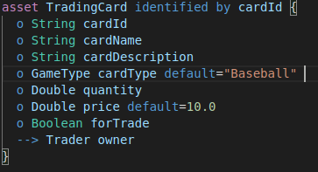
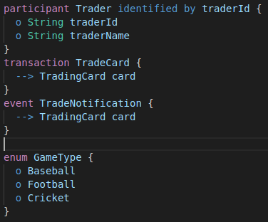
Code

Slide 30
Adding logic for our transactions
We add logic behind the transaction function using a Javascript logic file, which basically says to start the transaction event when only when the card is ready for trade and other user is trying to but it. Then, it fires off the trade notification event for that card.
Generating a Business Network Archive (BNA):
To make an archive file for our business network so we deploy it on our local Fabric runtime. This can we done using their respective commands in the terminal.

Slide 31
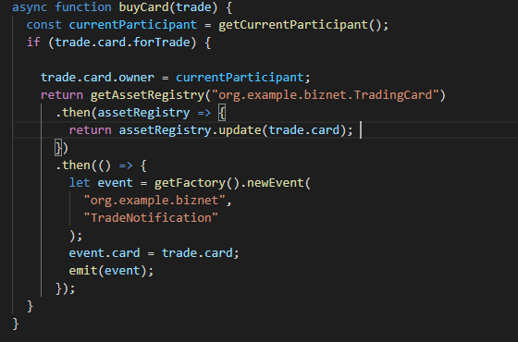
Code

Slide 32
Testing our Business Network
Start Composer Playground to interact with it and the playground opens in the browser:
Then connect to the trading platform. This is the page is where we can make changes to our code, deploy those changes to upgrade our network, and export business network archives.
This page contains details to add new participants as the Trader and then we can also add new card along with their details and makes transactions.
To make client-side software for users to provide them a seamless experience, they don’t even have to necessarily know about the underlying blockchain technology. For that we have the composer-rest-server module to help us with just that. This can be achieved by connecting to an existing business network with the card admin network card, and connect to an existing REST API as well.

Slide 33
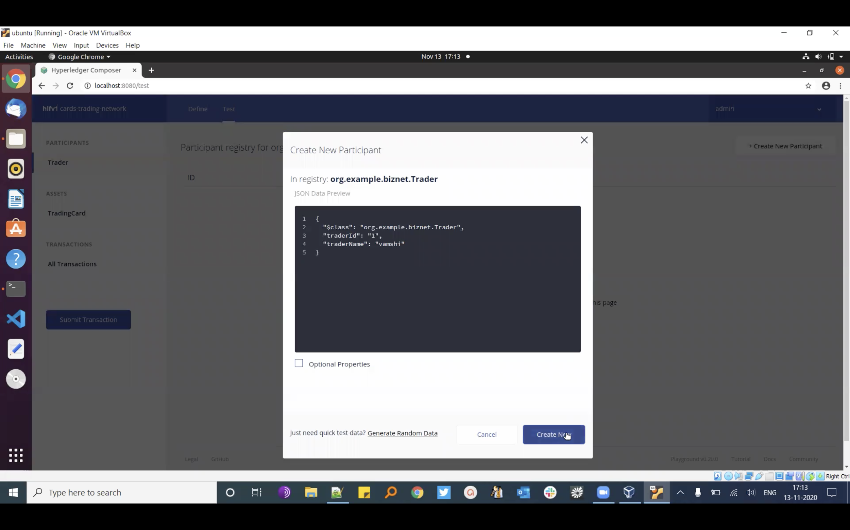
Product Results
Select Trader from Participants, click on Create New Participant near the top right, and make a new Trader similar to this:
Fig 1: Creating New participant

Slide 34
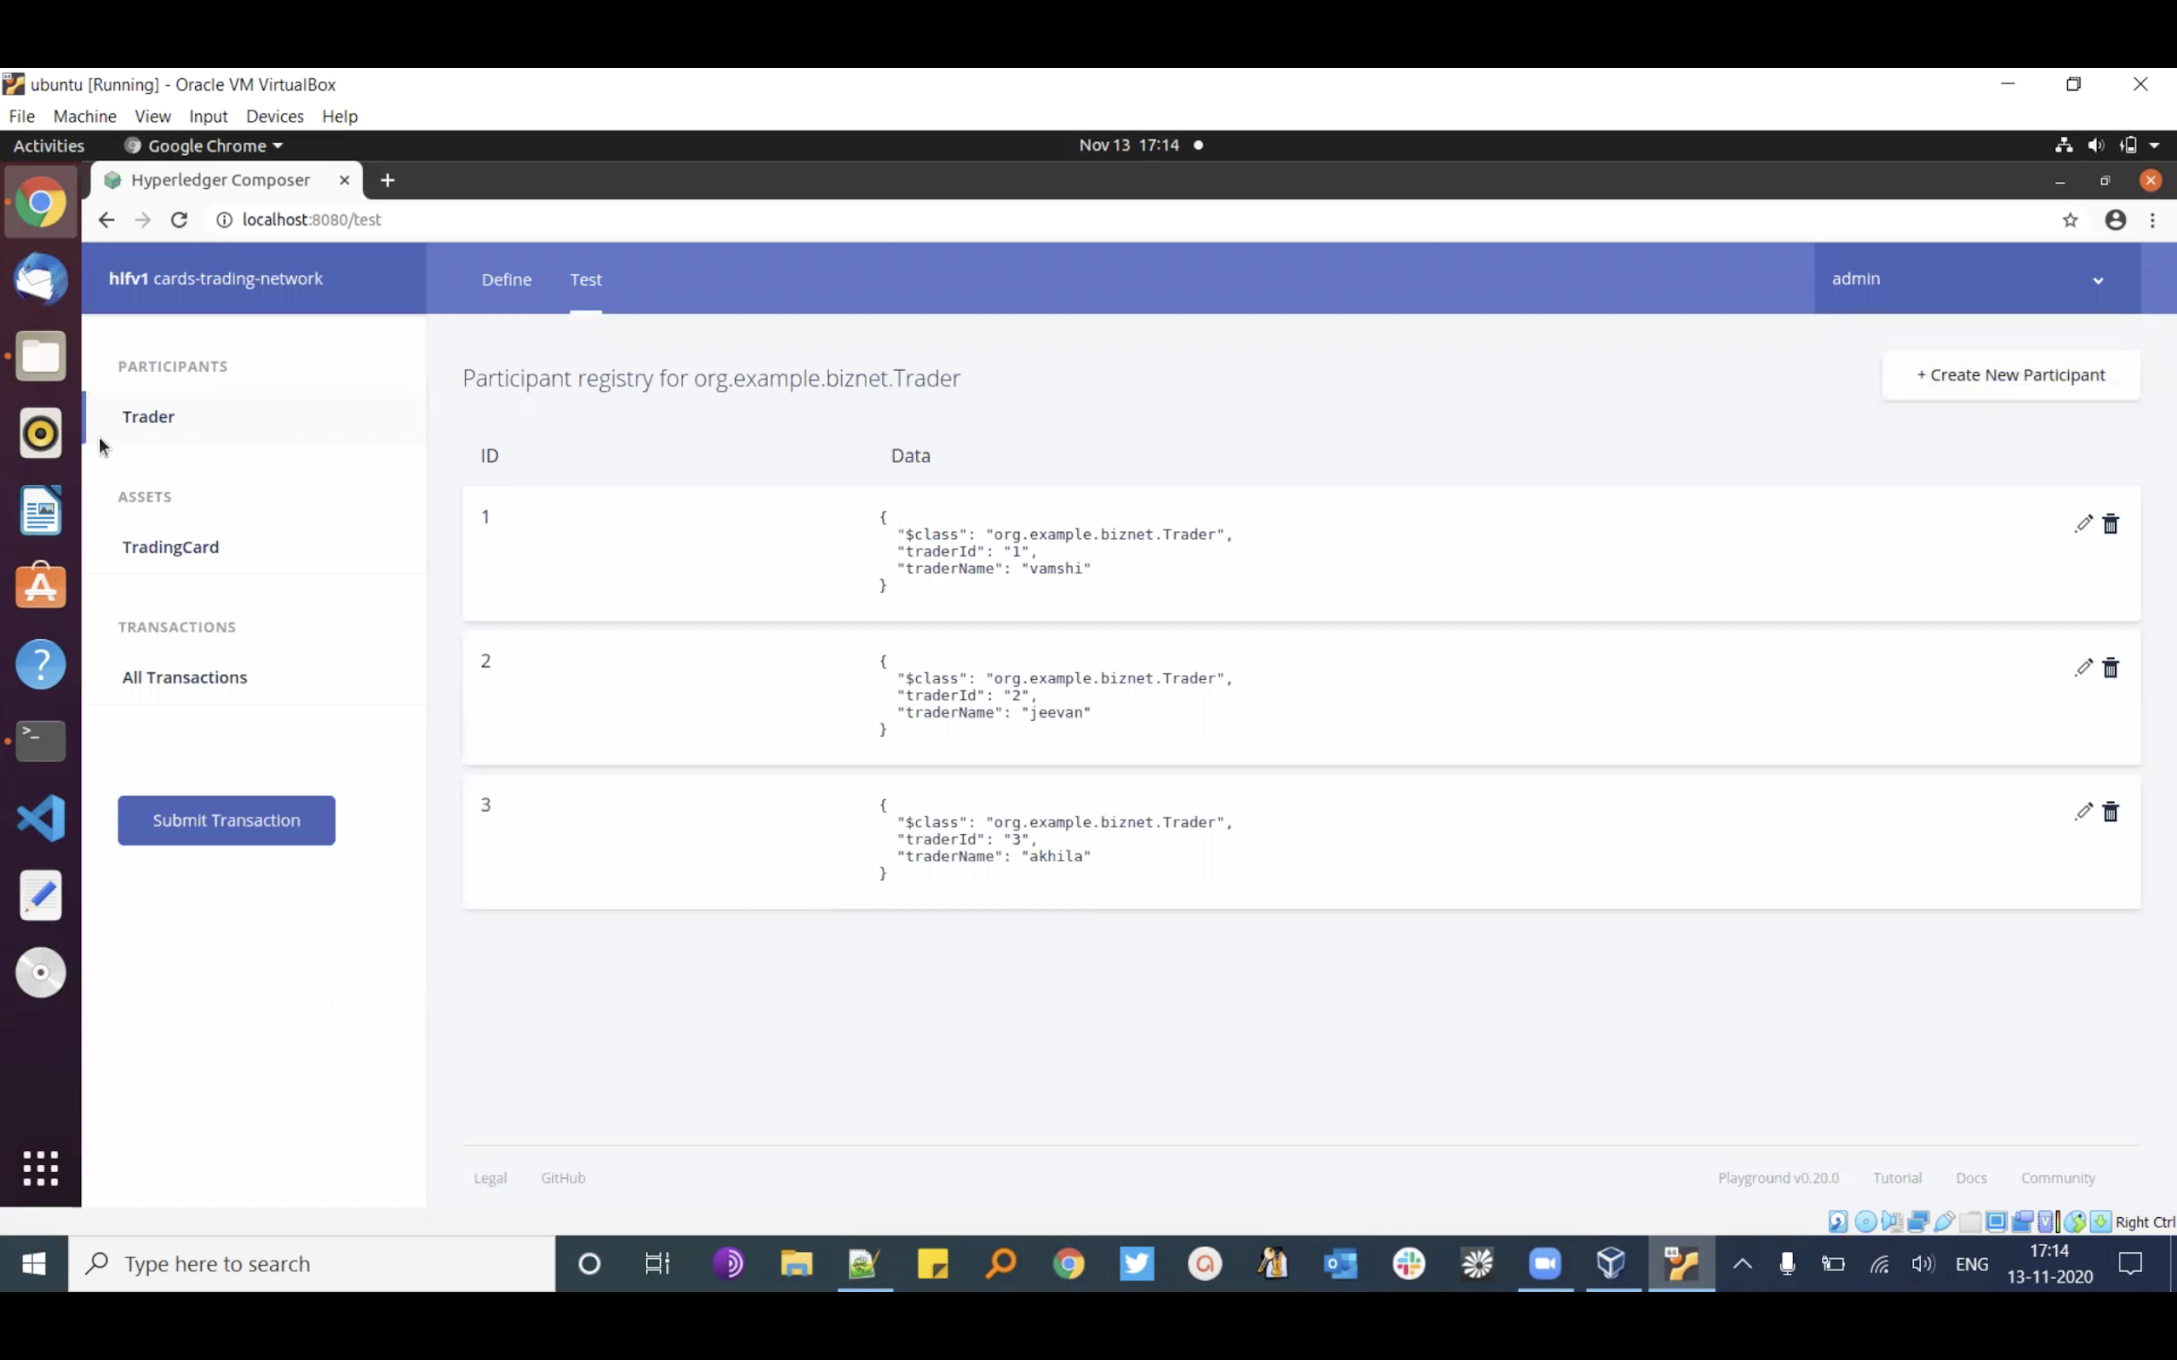
Go ahead and create a couple more Traders. Here are what our three traders look like with the names Vamshi, Jeevan, and Akhila.
Fig 2: Created Traders

Slide 35
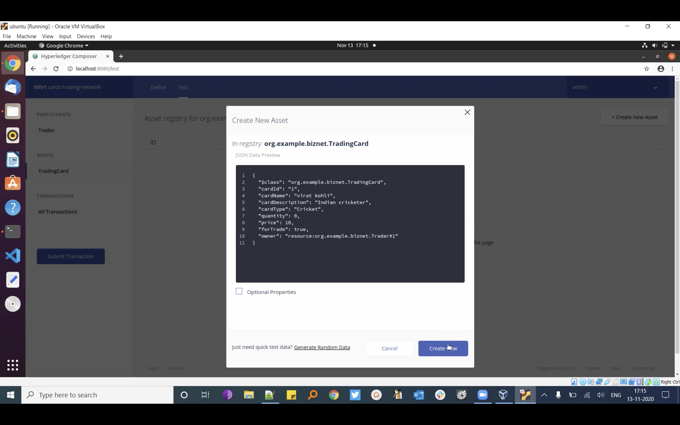
Fig 3: Creating New Asset

Slide 36
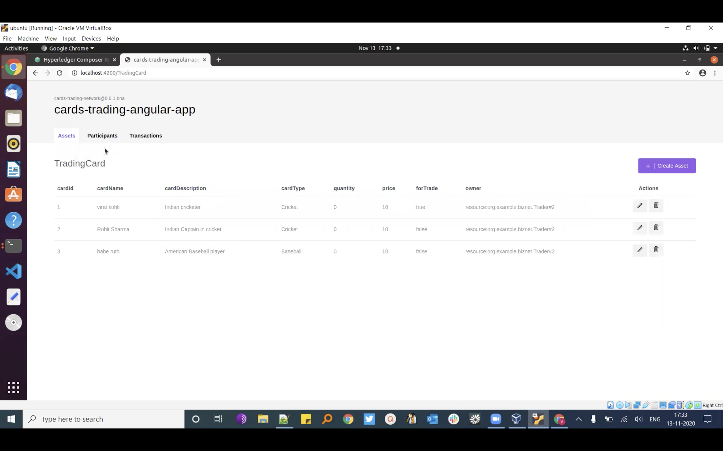
Now run npm install , give it a minute, and once it’s all done we’ll be able to load up http://localhost:4200/ and be greeted with a page similar to this:
Fig 4: Cards trading angular app

Slide 37
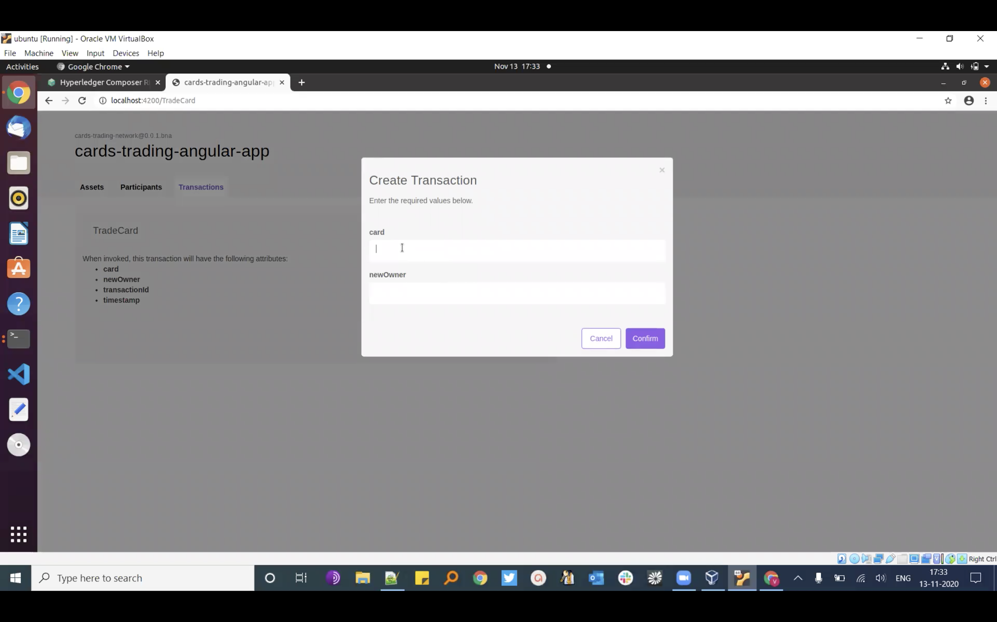
Now invoke and create a new transaction.
Fig 5: Invoke and create transaction

Slide 38
References
[1] https://hyperledger.github.io/composer/v0.19/tutorials/developer-tutorial
[2] https://blog.codecentric.de/en/2018/04/blockchain-application-fabric-composer/
[3] https://ieeexplore.ieee.org/document/9034576
[4] https://www.hyperledger.org/wp-content/uploads/2018/07/HL_Whitepaper_IntroductiontoHyperledger.pdf

Slide 39
Thank You!

